Slide 1

Symbolism in Tattoo Art
A major project overview

Slide 2
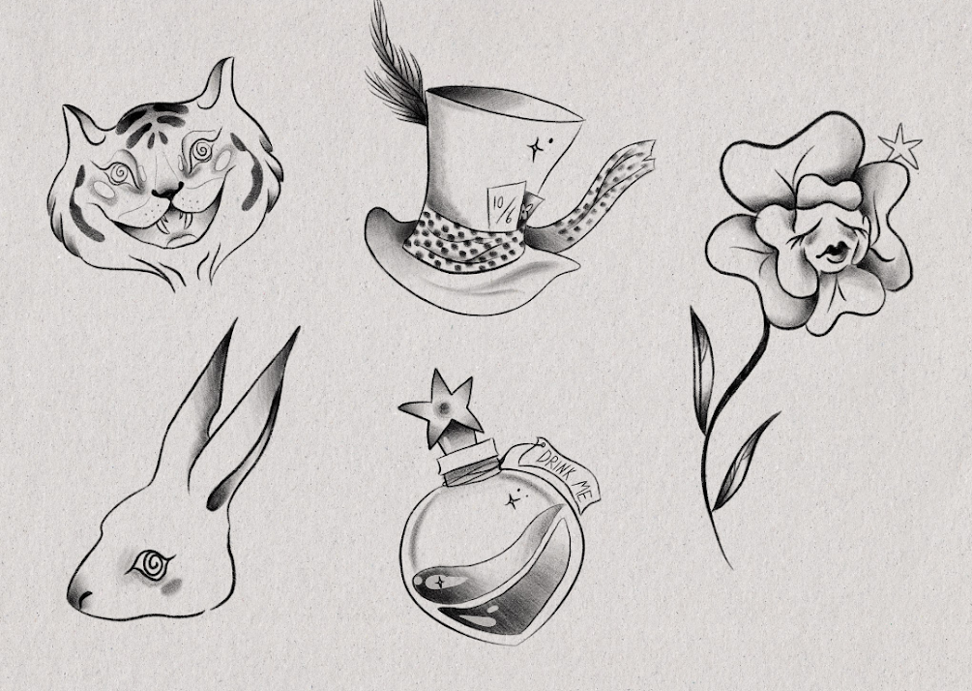
Project Overview
In this research dossier, we will delve into the fascinating world of symbolism and it's importance in the rich history of tattoo design. Symbolism has been an important aspect in all areas of design over the ages from Graphic Design to illustration, and in recent years (as tattooing has risen in popularity) we ask what place symbolism has in modern and ancient practises of tattoo art
This research will be split into 4 blog posts: Symbolism, Tattoo history, Symbolism in Tattoo Design, and finally a discussion of the Design Outcome.

Slide 3
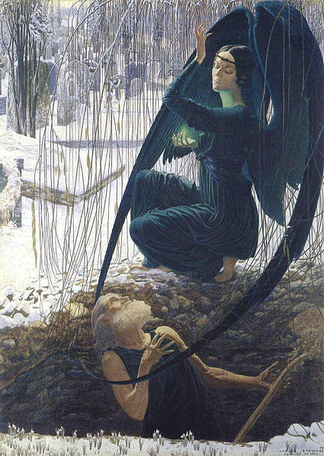
Symbolism
Symbolism began in late 19th century France as a literary movement. ‘Gilad Elbom’ of Oregon State University describes symbolism simply as : “the idea that things represent other things, (EG: The colour red meaning: love, passion, lust)”
Art, from the very beginning, has been and continues to be packed with symbolism: religious, thematic and societal.
Schwabe, C. (1890?) Death and the Grave Digger (Painting). Musee du Louvre, Paris.

Slide 4
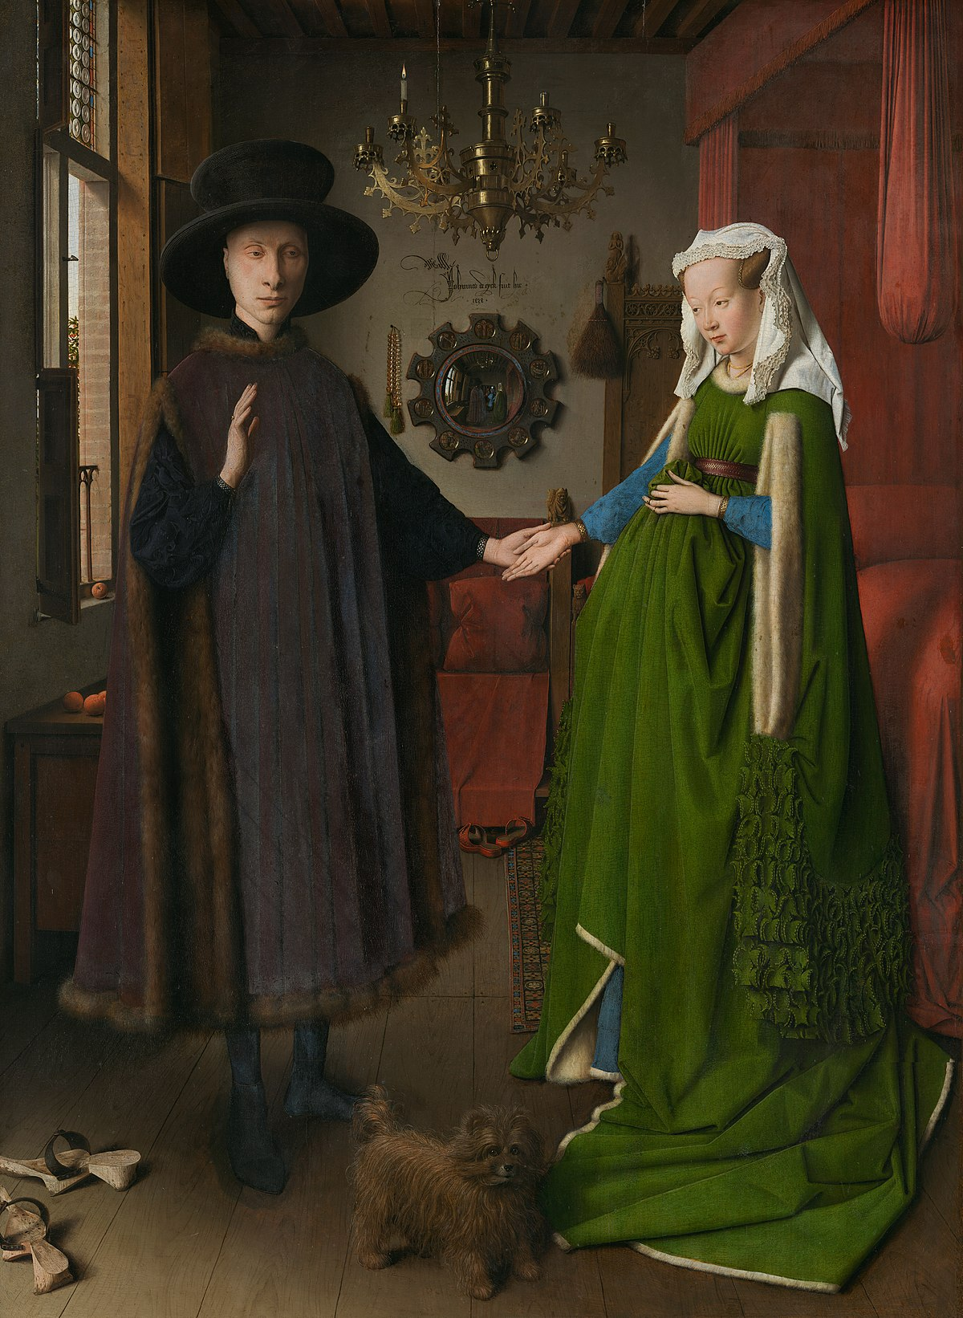
”Human beings communicate through art with symbols that transcend the boundaries of time and culture” (Clar, 1993)
Eyck, J, V. (1434) The Arnolfini Portrait (oil on oak). National Gallery, London.
Clar, R. (1993) An Art-and-Technology Payload for the Space Shuttle. Leonardo, 26 (Nr.4), 293-296

Slide 5

Tattoo History
Tattoo art dates back to around 3000 B.C and therefore the symbolism and purpose of tattoos has a rich history.
A lot of traditional 'old school' tattoo designs we see today were popularised by sailors and military men. 'Sailor Jerry' is by far one of the most influential tattoo artists of all time – based in Honolulu, Jerry specialised in ‘traditional’ designs and tattooed these on sailors and navy-men.
The societal acceptance of people getting tattoos has had a substantial impact on the popularity of being tattooed and the purpose.
Jerry, S. (?) TRADITIONAL TATTOO MEANINGS. Available Online: https://sailorjerry.com/en-gb/tattoos/ [Accessed 17/10/2022]

Slide 6
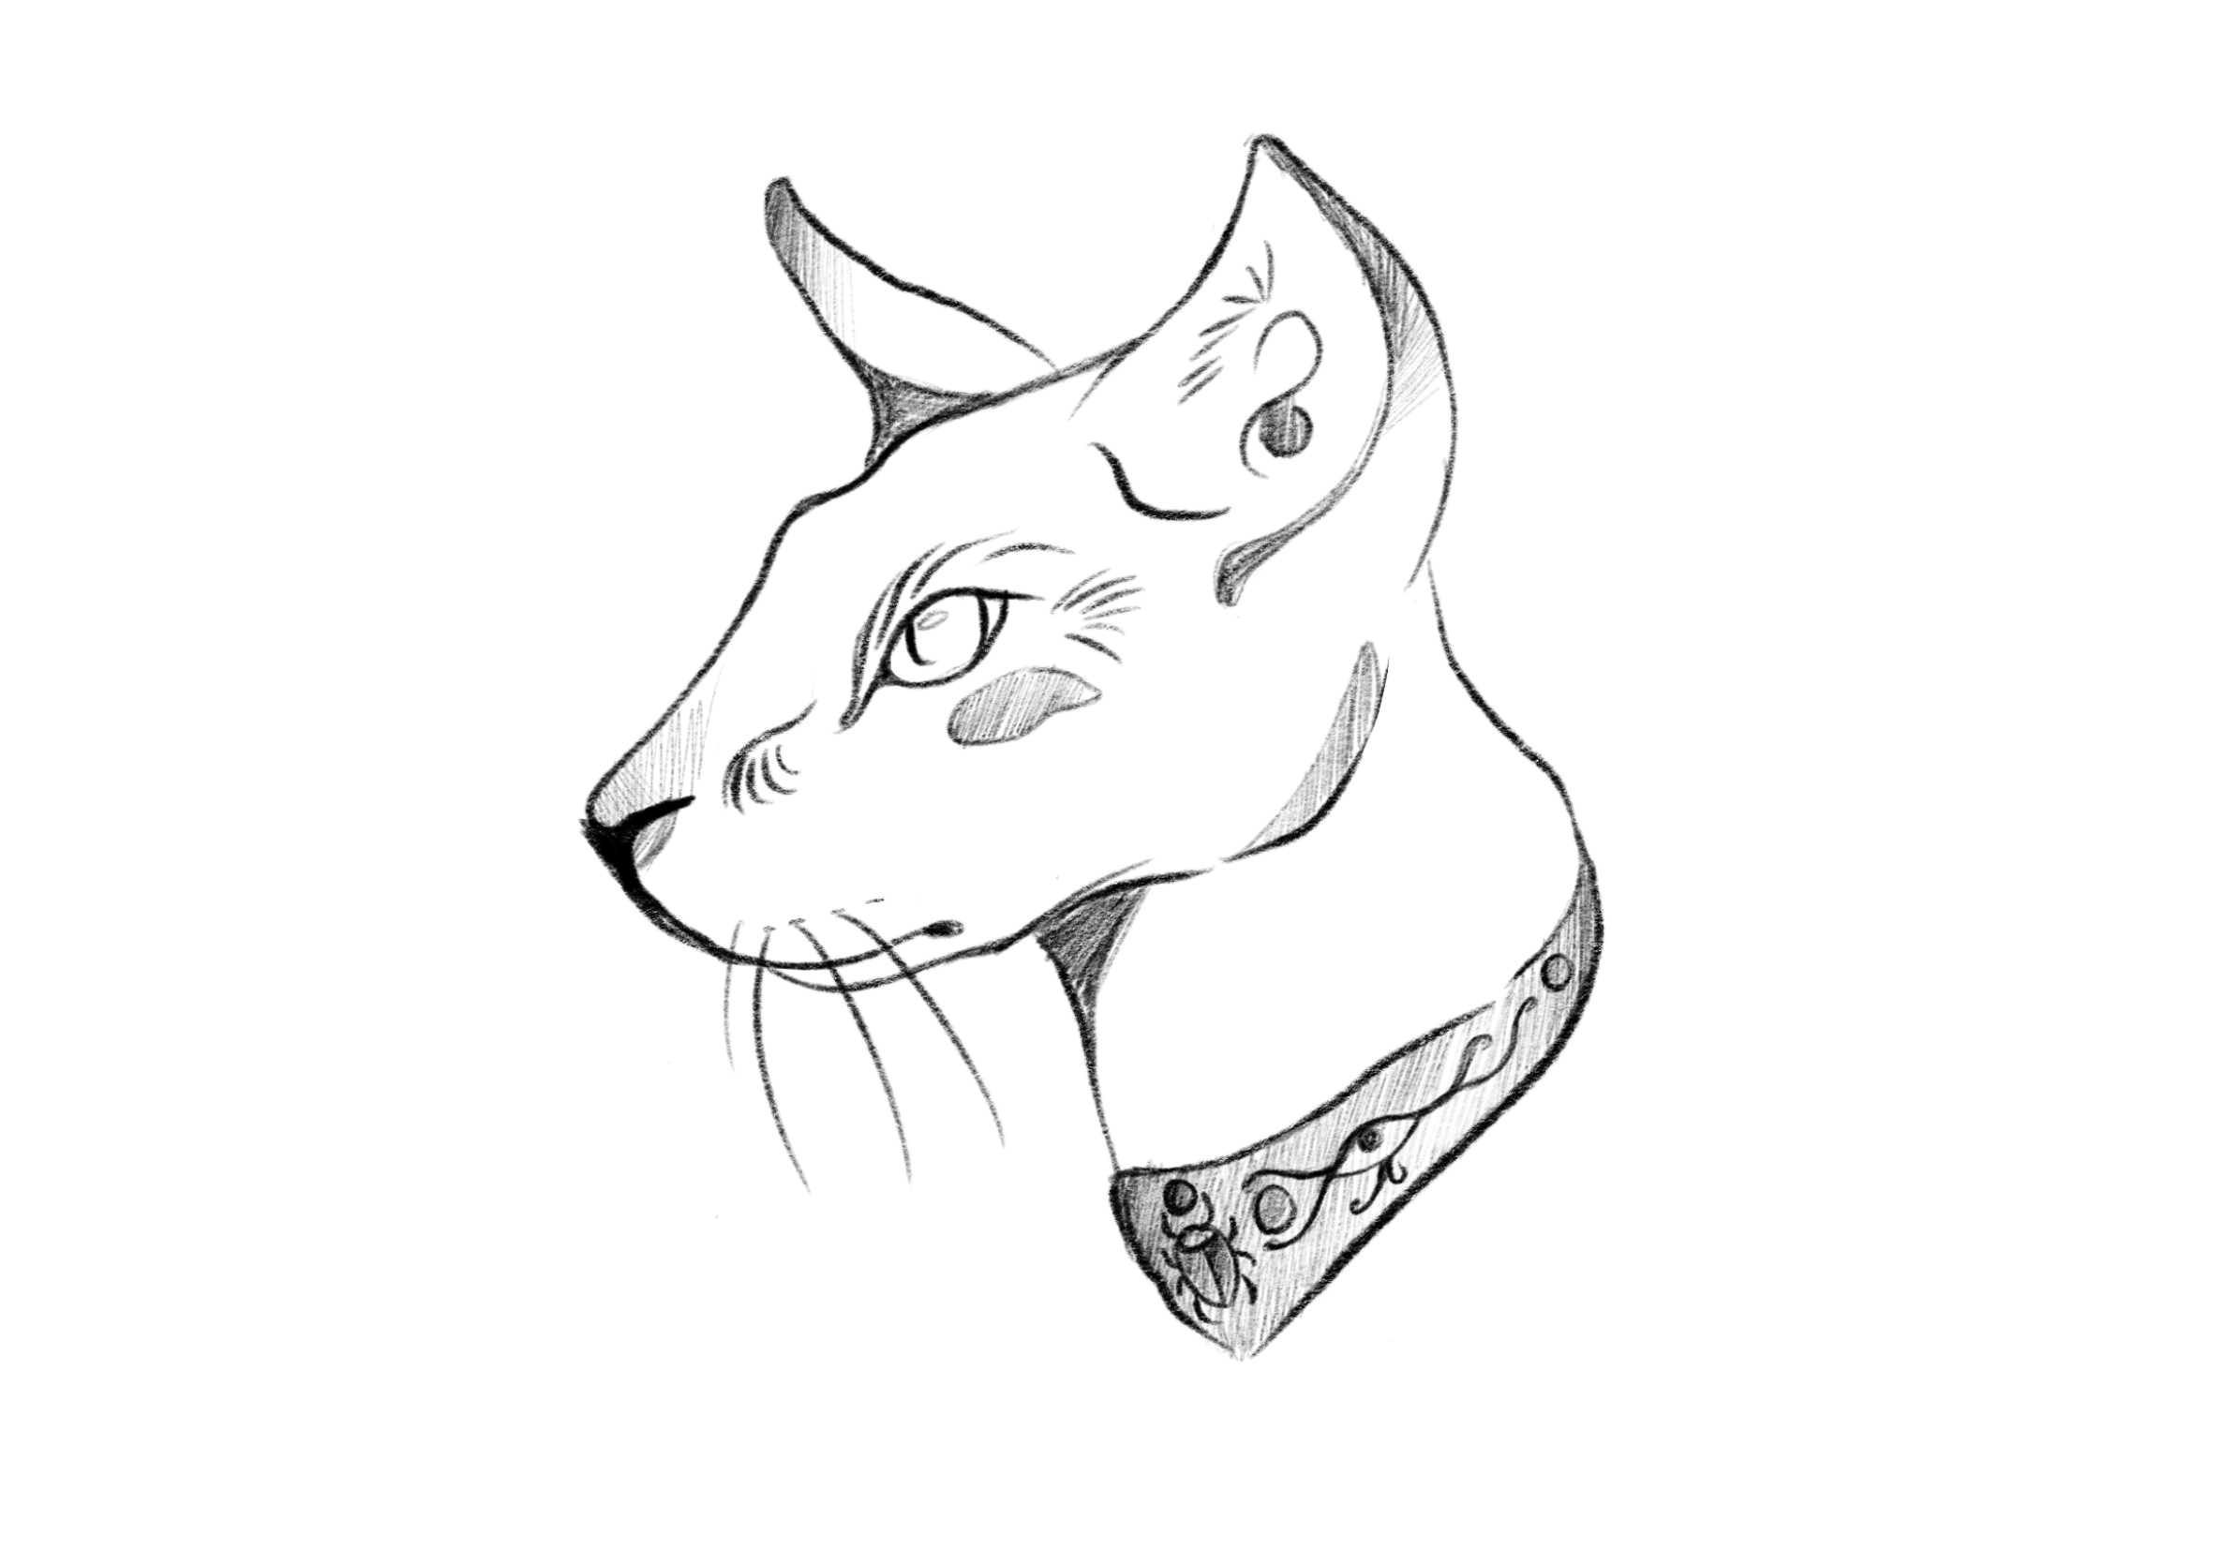
Symbolism in Tattoo Design
Recently, tattoos have risen in popularity thus creating different recurring imagery and symbolism in tattoo design. Tattoos have always been used as a form of identity and individuality therefore making each tattoo design unique and meaningful to the person getting it.
In 1991 a 5000 year old ancient mummy was discovered to have 59 tattoos. Mostly religious in nature, these tattoos represented the societal beliefs of the time and the personal spirituality of the individual.

Slide 7
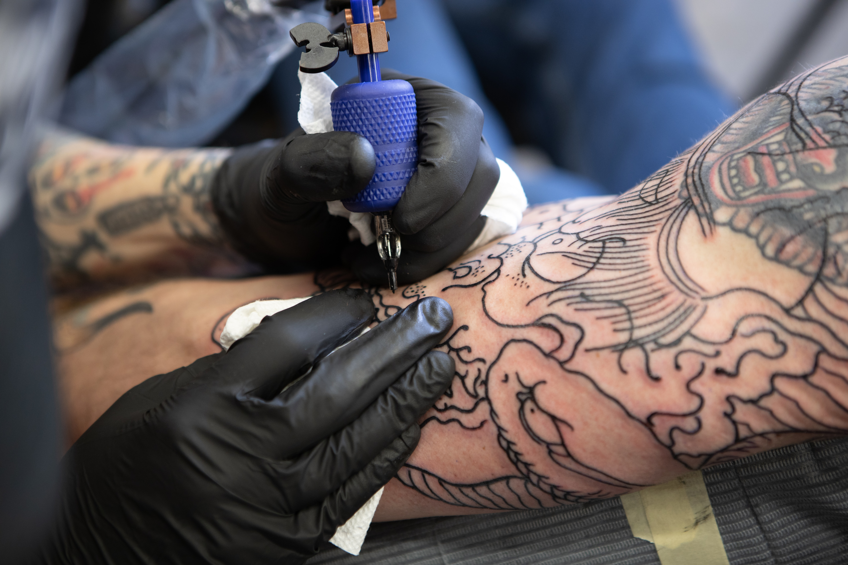
My Design Project
I would like to produce a portfolio of meaningful tattoo designs and tattoo a couple of these onto fake skin.
I intend to purchase a tattoo kit and log my progress of learning the machinery and the art of tattooing whilst also using my research to create symbolic and visually pleasing designs.
Lehman, B. (2020) A young man gets a tattoo cover-up. [photograph] Available online: https://unsplash.com/photos/5t4qCgtaLGU [Accessed 13/12/2022]

