Slide 1

My Bridlington art installation
Jessica Corbett

Slide 3
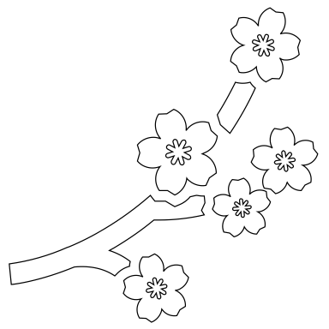

Basic idea
My interactive art installation will tell the stories of local (Bridlington and Yorkshire) myth and legend
My inspiration came from the Japanese film ‘pom poko’ and the ‘yokai’ parade
I plan to use projections in an inside setting to tell the stories

Slide 4

Story research
https://imfromyorkshire.uk.com/5-great-yorkshire-legends/
This link had some interesting myths that I can use:
The bridlington area was once a haven for wolves
Ley lines - ancient monuments and paranormal happenings
Werewolf story – ‘Old stinker’ the werewolf known for his bad breath
‘The Gypsey race river’ known as the waters of woe – rises above the surface only before something terrible is about to happen
Great meteor fell in December 1795
Rudston Monolith - https://www.hulldailymail.co.uk/news/hull-east-yorkshire-news/secrets-rudston-monolith-east-yorkshires-2387238

Slide 5
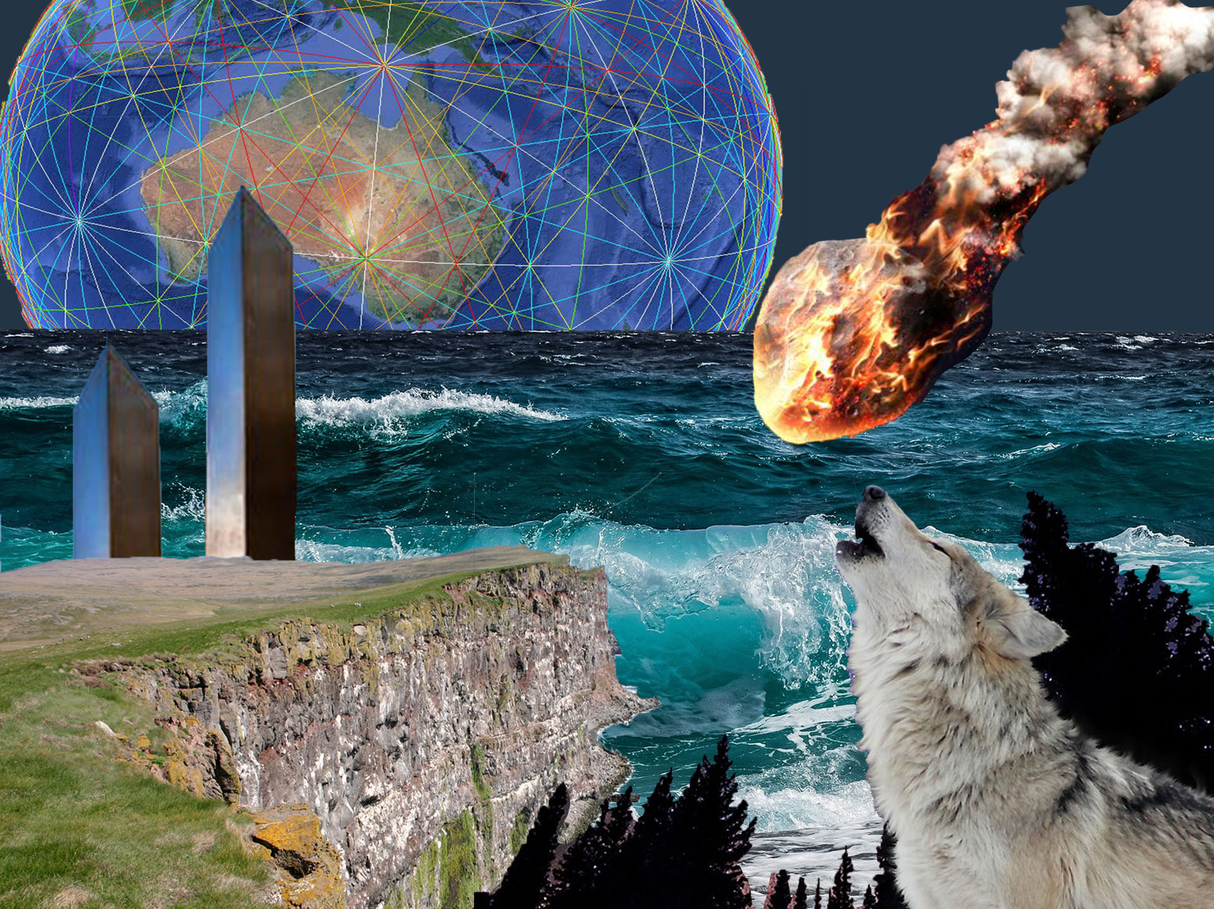

Slide 6
Practical requirements and issues
A good lighting and projection system
Sizing and scaling of projections to fit the dome
Low light levels
Projections on uneven surfaces
Engineers on site
COVID-19

Slide 7

COVID-19
Obviously at the moment any art installation that encourages groups of people to gather inside is dangerous and must be altered.
I would make sure that masks are mandatory inside the dome and that only a certain number of people would be allowed in the dome at one time.
I would also make sure that the two metre rule was enforced by sectioning the floor up, similarly to supermarkets at the moment.
https://www.displaysigns.net/covid-19-signs/

Slide 8
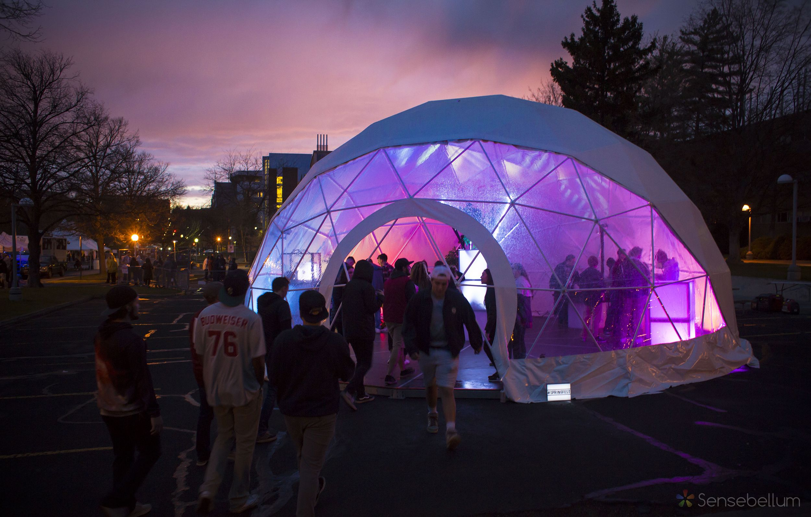
Placement
I think that a dome would fit this installation perfectly – here are a few reasons:
The artwork could be projected all around which would make the audience feel immersed into the stories
The sound would be surround sound and again feel very interactive
The inside would mean accurate projections and little issues (unlike my previous ideas) – it is not reliant on the weather being good for it to work and will offer shelter if the weather isn’t very nice.
https://www.sensebellum.com/wsu-springfest-sensatorium-interactive-art-installation

Slide 9
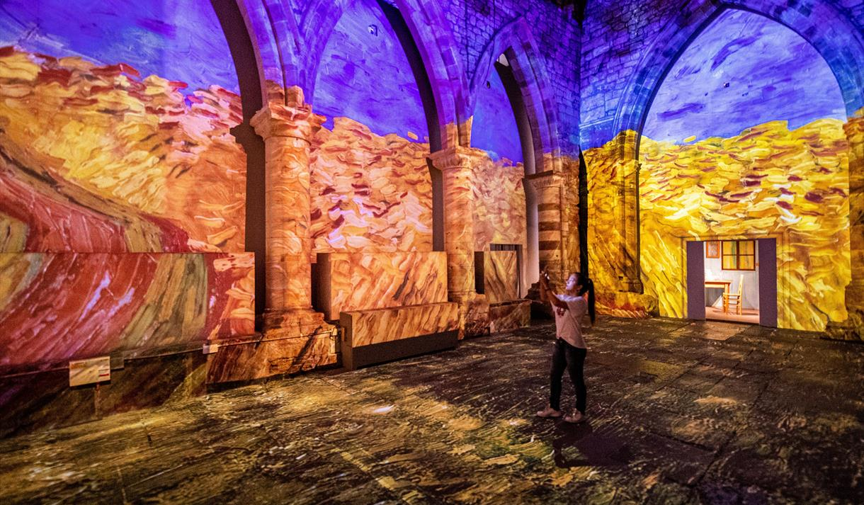
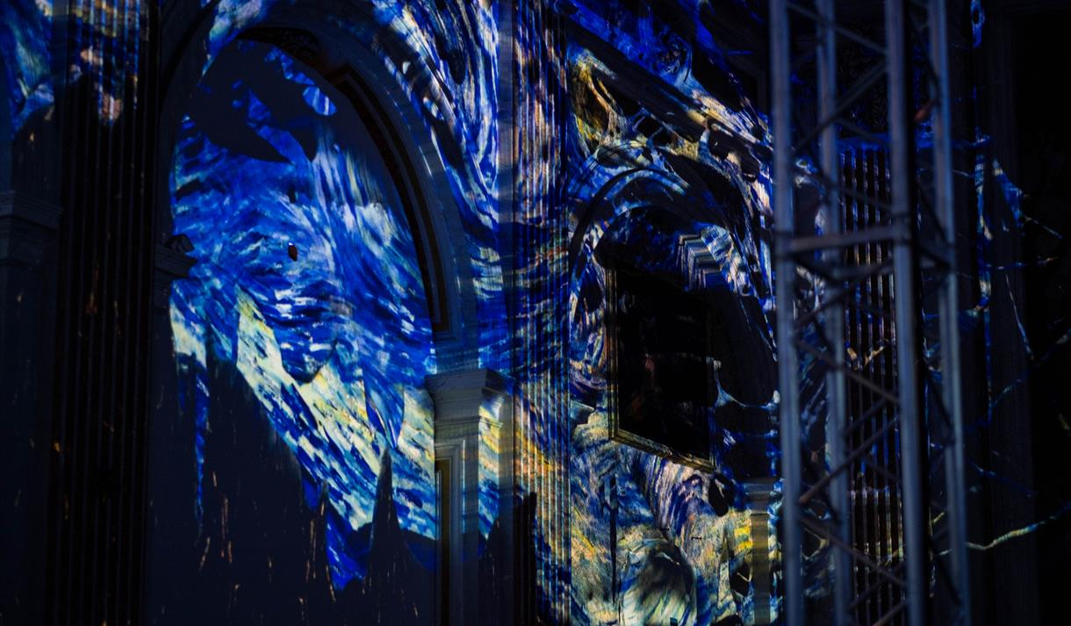
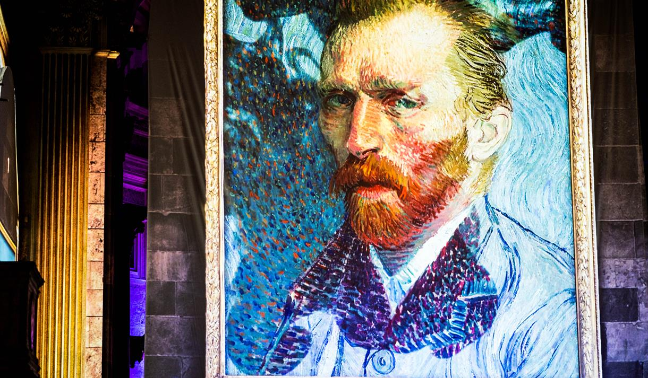
Van gogh : the immersive experience - York
https://www.visityork.org/explore/van-gogh-the-immersive-experience-p1110971

Slide 10
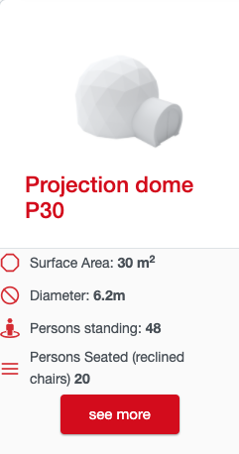
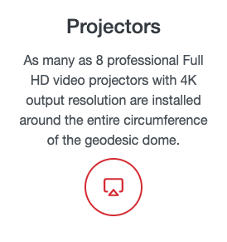

Tech research - video
Projector – https://polidomes.com/projection-domes/
I would contact and use this company – Polidomes – a company that specialize in projecting immersive experiences in dome shaped venues.
This is the option that I would choose

Slide 11

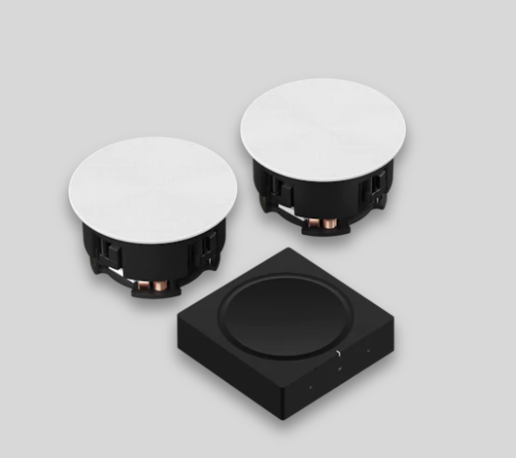
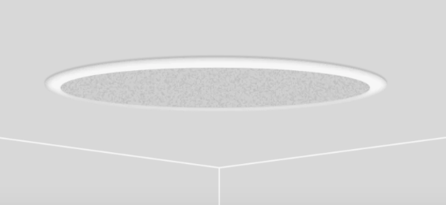
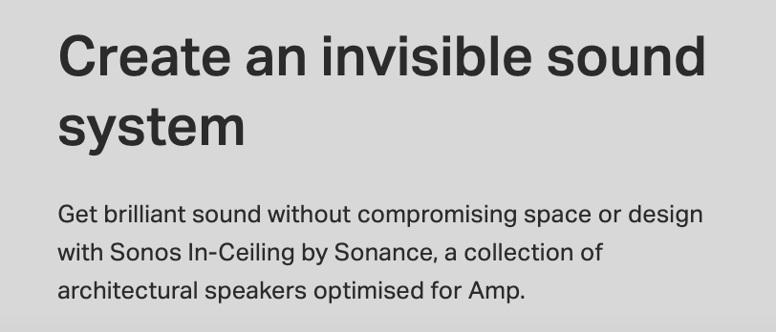
Tech research - sound
I would use in-ceiling speakers to create the surround sound effect and immersive experience.
I would use these ‘Sonos’ speakers to create a surround sound experience, placing multiple speakers (approx. 5) around the dome
As they are designed to fit into the walls of the dome, they will not compromise the immersion or design.
https://www.sonos.com/en-gb/shop/amp-and-ceiling-set.html?gclid=Cj0KCQiA6Or_BRC_ARIsAPzuer8ycKR7tN-850koO108JGy91VzE5Qt6lQF_ZqkmY74tJYCvgD2pE9gaApsbEALw_wcB&gclsrc=aw.ds

Slide 12

Animation + sound ideas
The wolves eyes could appear yellow all around the audience , then two big red eyes of the werewolf could pop out and get bigger – you then see ‘old stinker’ howl at the moon at the top of the dome
The Rudston monolith could burst out of the ground and the sound could rumble
The waters of woe could flow all around the dome – with ocean and river noises
The ley lines could pop up and connect across the dome in different colours
Then the great meteor could crash down and explode into a firework like display
I would like there to be a running commentary all throughout explaining and telling the stories
Notes:
Reminder that this will all be 2d artwork projected across the dome

Slide 13
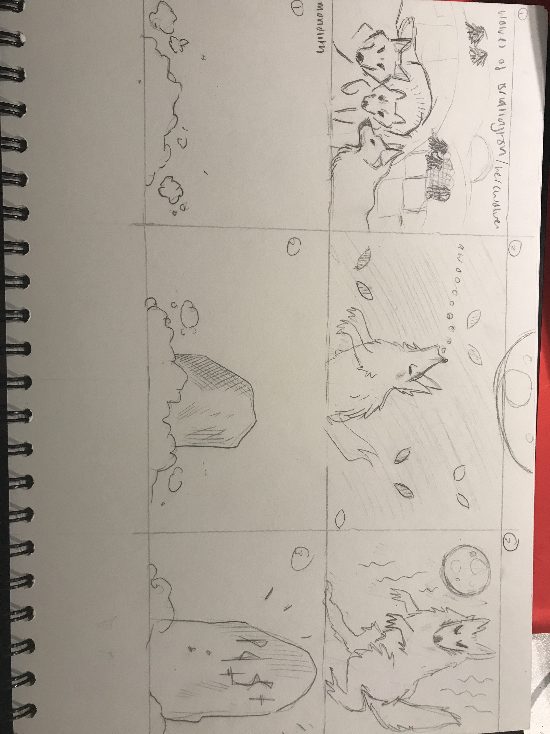
Storyboards for my projected stories

Slide 14
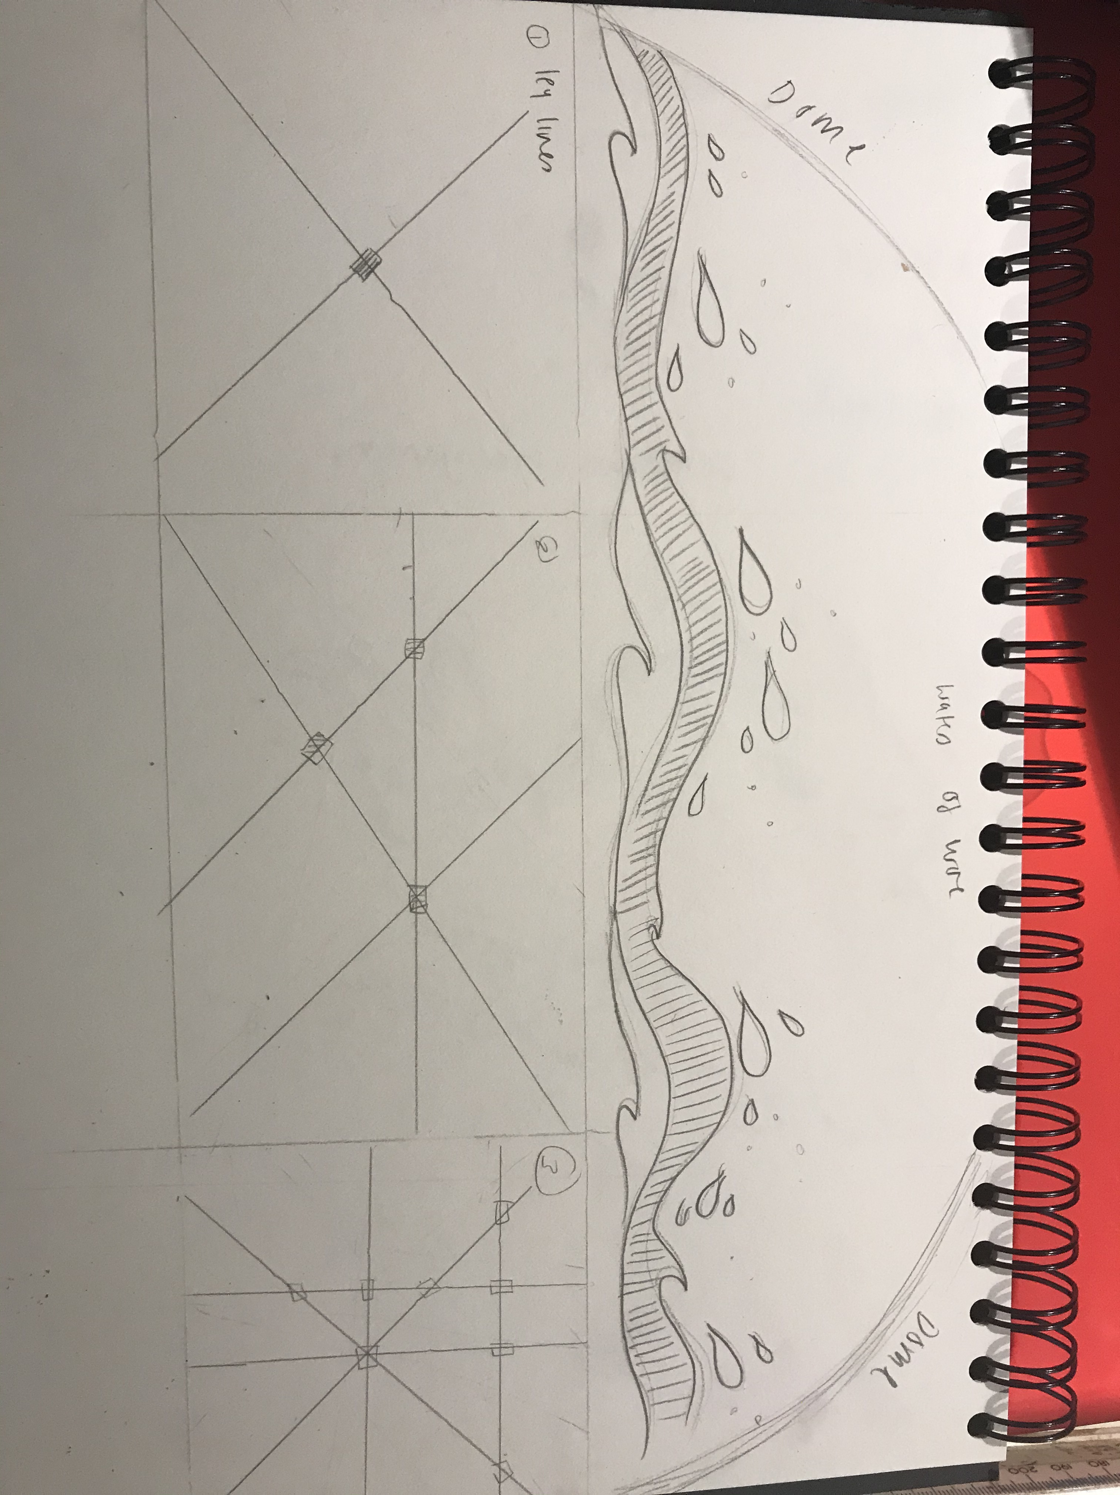
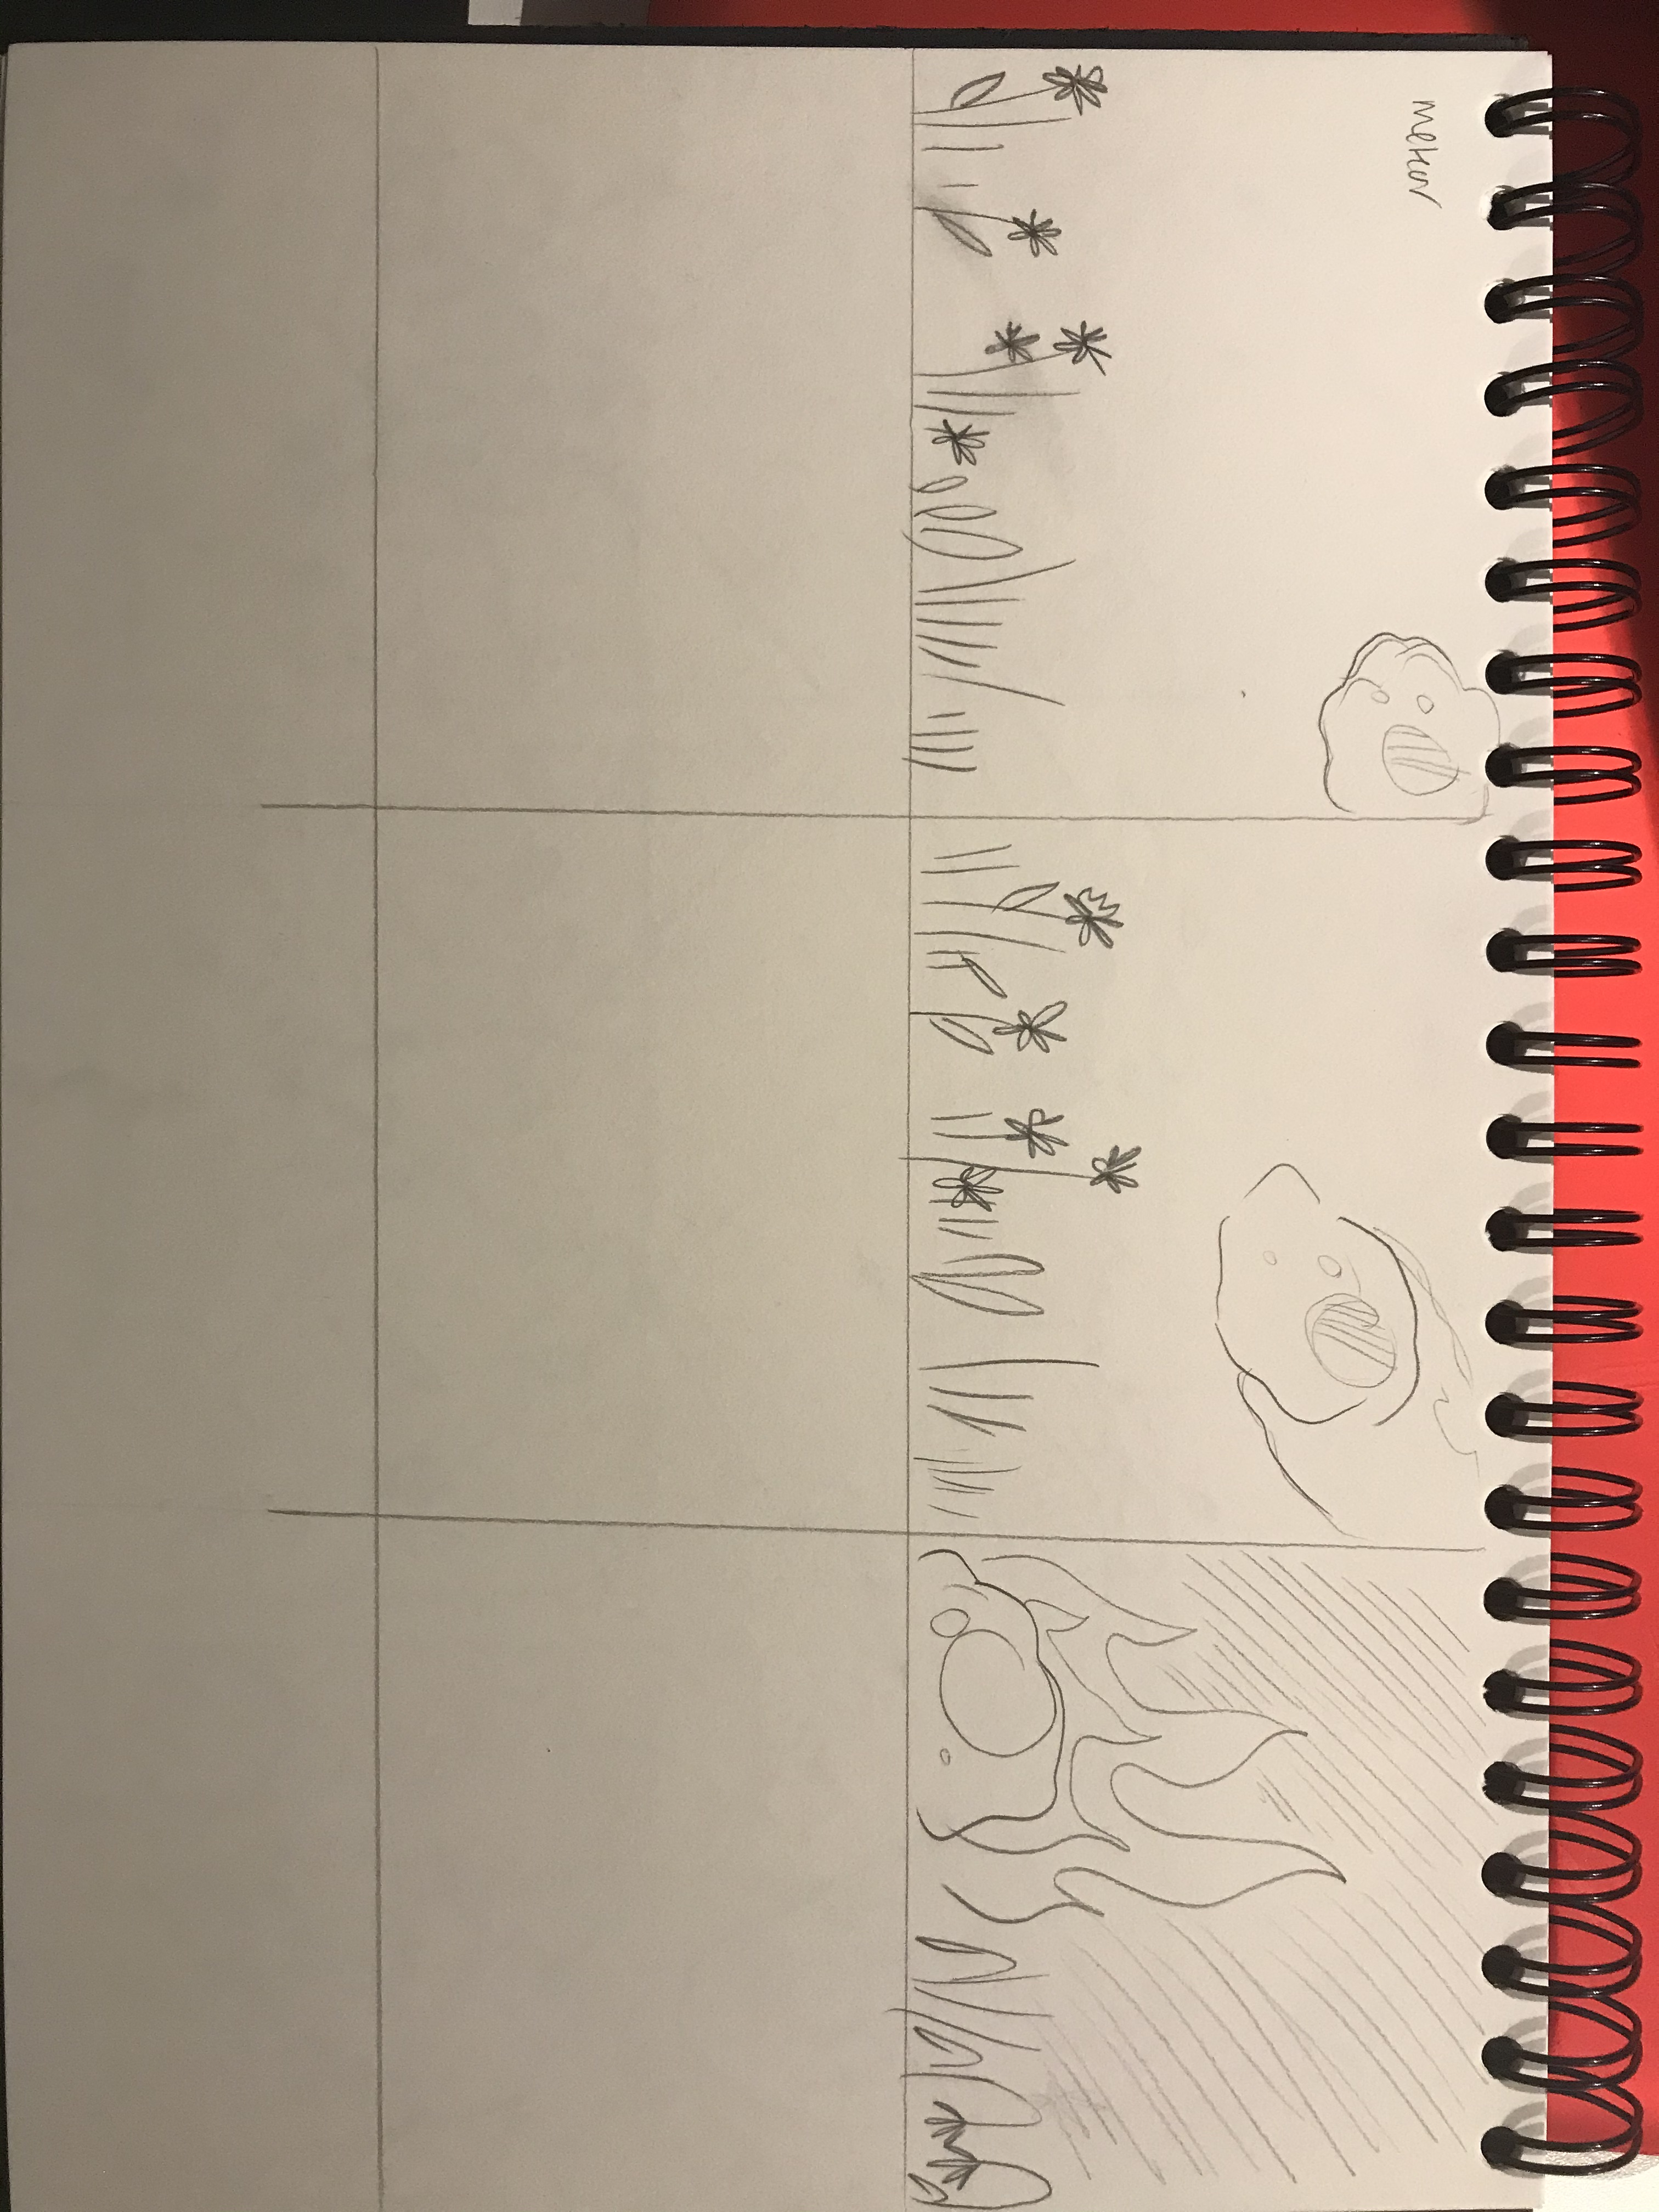

Slide 15
Thank you for watching

